Slide 1
Class Test Trial
COSMATT Accounting
Notes:
1

Slide 2
Table of Contents
Overview
Content
Requirements
Design Queries
UI/UX Mocks
Student View
Instructor View
Notes:
2

Slide 3
Overview

Slide 4
Overview
Goal
To run a class trial of COSMATT Assessments (Problem Sets) with a sample of 50 – 100 students in order to test the user experience and gather user feedback
Feedback will be used to 1) improve the user experience and 2) provide data for the academic paper
Plan
To create a set of end-of-semester questions for students to earn an extra credit
The questions have been selected from various sections of the COSMATT Introduction to Financial Accounting demo
Questions
This is a 15 – 20 min test consisting 8 questions
The question types include Multiple Choice, Standalone Spreadsheet (Leonardo) and select Modules of the Comprehensive Problem (Leonardo)
Student Feedback
After completing the assignment, students will be asked for feedback on the user experience
Feedback will be captured from students in form of Objective and Subjective Questions
Evaluation & Assessment
Students: Students will be able to see the results of the questions attempted (Student View)
Instructor: Instructors will be able to review Student’s individual results, aggregate class results and student comments (Instructor View)

Slide 5
Requirements
Access to the Questions
No authentication required. Student just enters his name, email and class.
Identity of the Student is established by his emailed (New vs Revisit)
Home Page - Contents should include the following:
Institution Name – University of North Georgia (Chris to confirm)
Class – Dropdown (to be selected by the Student) (Chris to confirm values)
Student Name – Textbox (to be entered by the Student)
Student Email ID– Textbox (to be entered by the Student)
Date and Time
Time Taken to execute
Question Navigator
8 Questions
Each question can be submitted individually

Slide 6
Requirements (continued)
Feedback section
Capture feedback from the student at the end of the assignment after the student submits the last question
Allow for comments at the end of the feedback section
Reports / Dashboard (Student / Instructor View)
Student View
Question List with Status of each Question (i.e. answered correctly or incorrectly)
Total Time Spent
Instructor Dashboard
Summary Analytics of each student, one row per student
Displays Question Counts – Correct, Incorrect, Unattempted
Instructor can drill down to analytics of each student

Slide 7
Selected Content
8 Questions Selected
Chapter 1> Section 1.1> Question 2 (Net Income) – Multiple Choice Question
Chapter 1> Section 1.1> Question 3 (P & L chart) – Chart Assessment
Chapter 1> Section 1.1> Question 5 (Business Type) – Multiple Choice Question
Chapter 1> Section 1.4> Question 1 (Transaction) – Multiple Choice Question
Chapter 1> Section 1.4> Question 2 (Transaction) – Multiple Choice Question
Chapter 1> Section 1.5>Assessment 1 (Accounting Equation grid) – Leonardo
Chapter 5> Section 5.2>Journalize transactions – only 6/1 through 6/8 - Subset of Comprehensive Problem - Leonardo
Chapter 5> Section 5.5> Given a completed trial balance, prepare the three financial statements - Leonardo

Slide 8
Queries

Slide 9
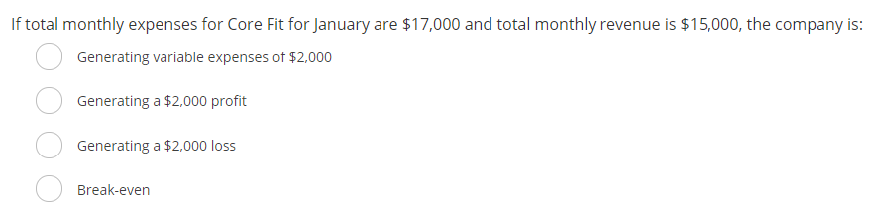
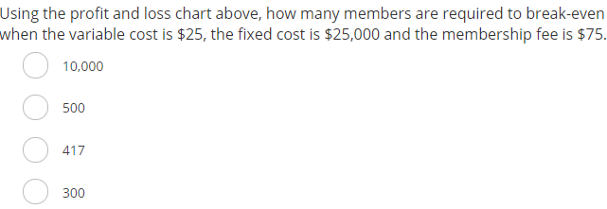
Content Queries
Chapter 1 > Section 1.1 > Question 2 (Net Income) (Multiple Choice Question )
Queries: Question to be reworded to Introduce Core Fit?
Chapter 1> Section 1.1> Question 3 (P & L chart) – Chart Assessment
Queries: Question to be reworded to include Narrative about the Core Fit Use Case as well as the Chart
Need a backup / replacement Question considering the timeline and complexity of implementing this

Slide 10
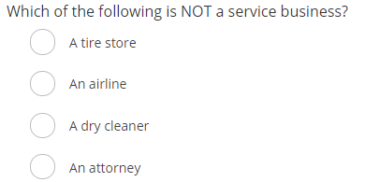
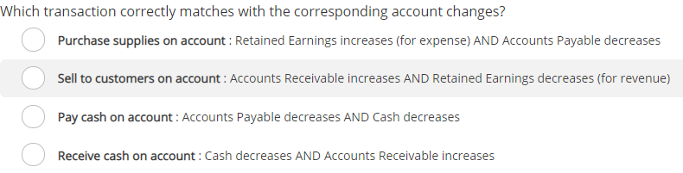
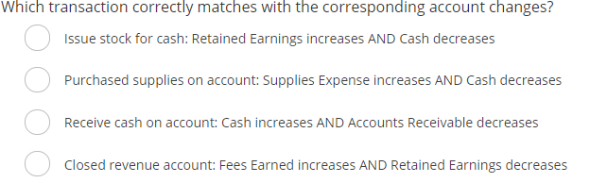
Content Queries
Chapter 1> Section 1.1> Question 5 (Business Type) – Multiple Choice Question
4. Chapter 1> Section 1.4> Question 1 (Transaction) – Multiple Choice Question
Question 2 (transactions
Queries: Do Question 4 and 5 still work now that we have removed RE in the narrative?

Slide 11
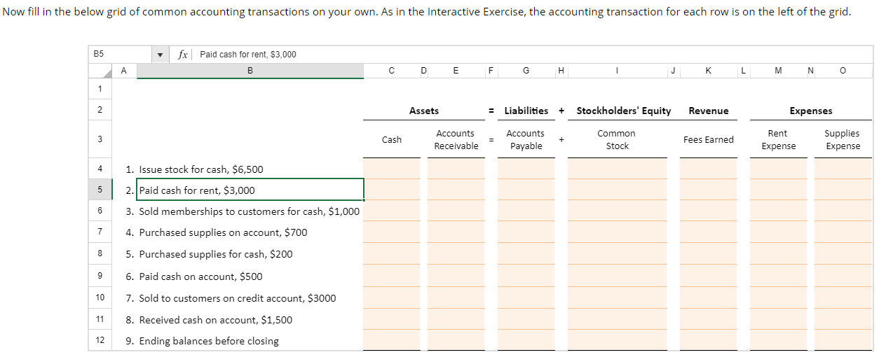
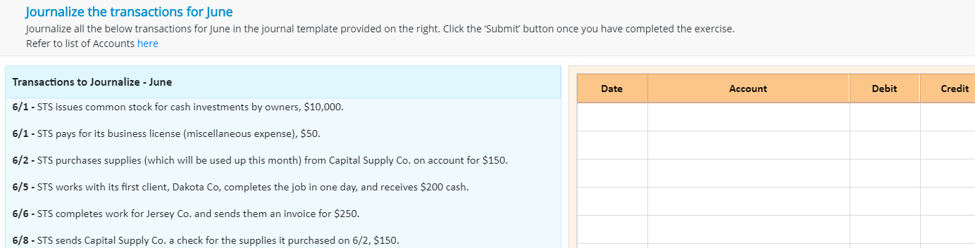
Content Queries
Chapter 1> Section 1.5>Assessment 1 (Accounting Equation grid) – Leonardo
Chapter 5> Section 5.2>Journalize transactions – only 6/1 through 6/8 - Subset of Comprehensive Problem – Leonardo
Queries: Question to be reworded? Or some Narrative about the STS company to be added?

Slide 12
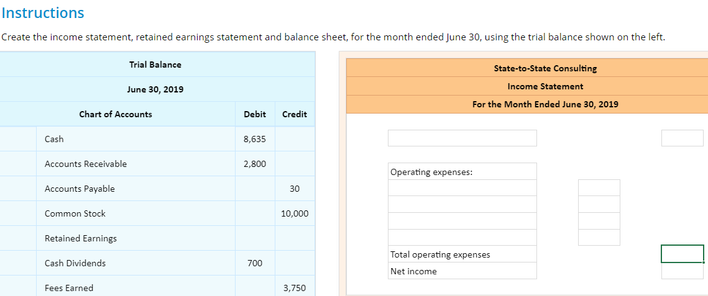
Content Queries
Chapter 5> Section 5.5> Given a completed trial balance, prepare the three financial statements - Leonardo

Slide 13
Design Questions
# | Question | Our Assumption
1 | Should there be an option to Submit each Question as it is answered or Submit All only at the end of the Assignment? | With each Question
2 | Should we provide instant feedback (Answers) after Submitting each Question? | Yes
3 | Is the “Try Again” Option needed for each Question? | No. Only 1 attempt per Question
4 | Will it be a timed test? Does time need to be tracked for each Question or just the total exam time ? | No. Time will be tracked but there will be no time limit Time tracking for the total exam not for each question
5 | What will the Reports show (Scores, Correct/Incorrect, Attempted)? | No scores. Correct, Incorrect and Unattempted results will be shown for both Student and Instructor View
6 | Should capturing Student Comments/Feedback be mandatory? | Yes. Not at Question level but at the assignment level. Only once feedback has been submitted will the student gets access to report.
7 | Name / Title of the Assignment to be used on the home page? | Title Options: COSMATT Accounting Lab / Exam / Questions Experience COSMATT Accounting Experience Trial COSMATT Extra Credit Questions
8 | Are there any other parameters that need to be captured? | ?

Slide 14
Design Questions
# | Question | Our Assumption
9 | What device will be used by the Students to run the test? | Desktops or Laptops (Not planning to support for Tablets or Mobile)
10 | Need to have a backup Question for the Interactive Chart Question type | ?
11 | What Questions are relevant for capturing Student’s feedback | Sample questions are provided in subsequent slides. Can be modified / added / removed as needed

Slide 15
Mocks

Slide 16
Student Workflow

Slide 17
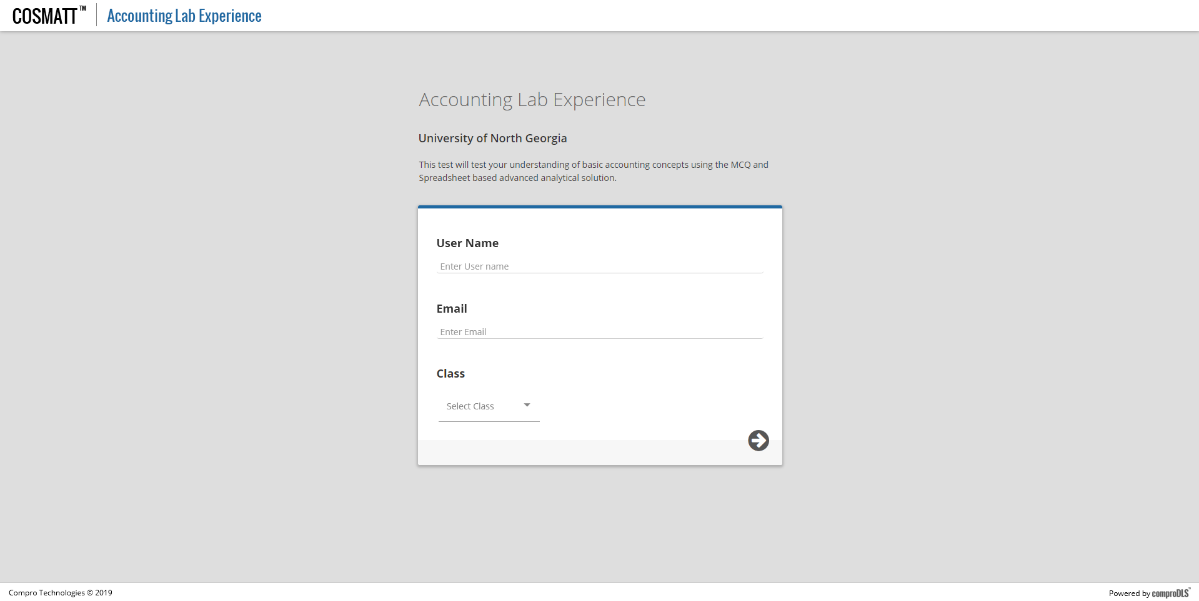
Mocks – Landing Page

Slide 18
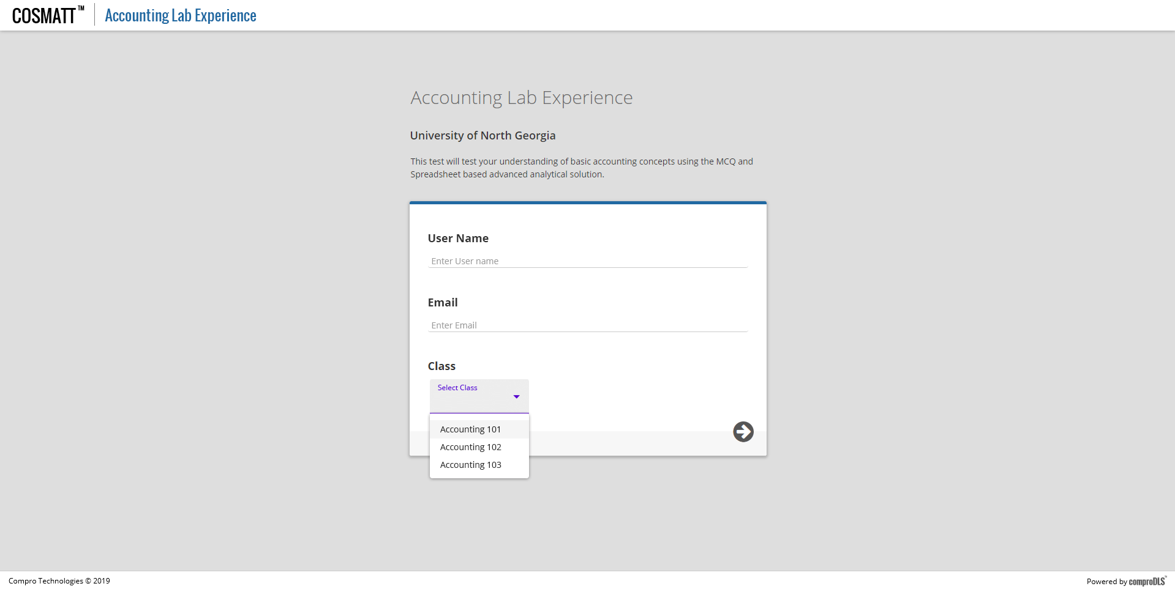
Mocks – Landing Page

Slide 19

Mocks – Landing Page

Slide 20
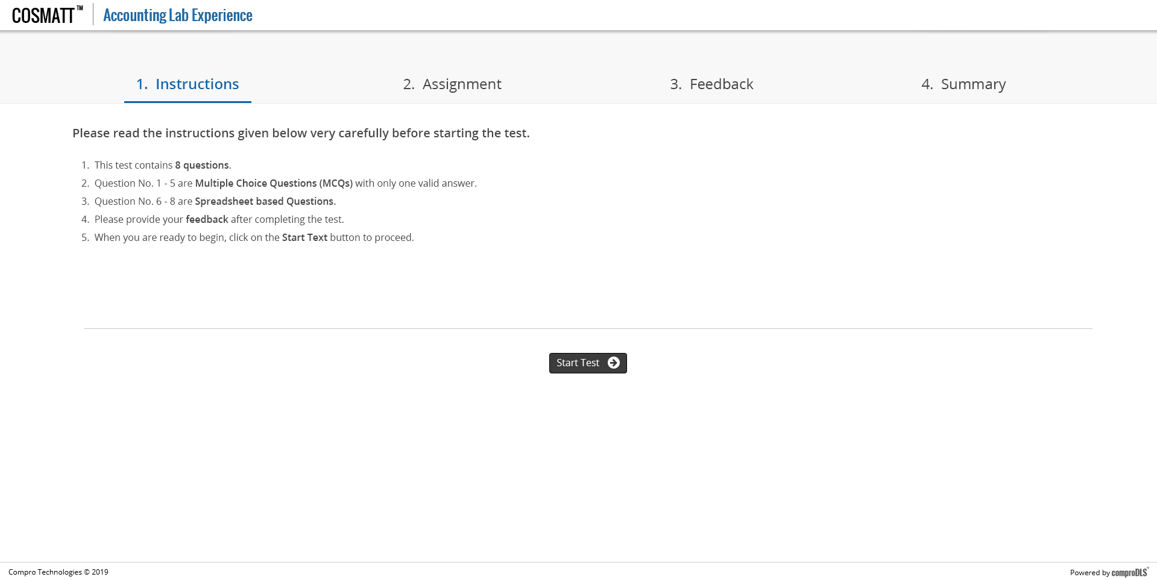
Mocks – Home Page

Slide 21
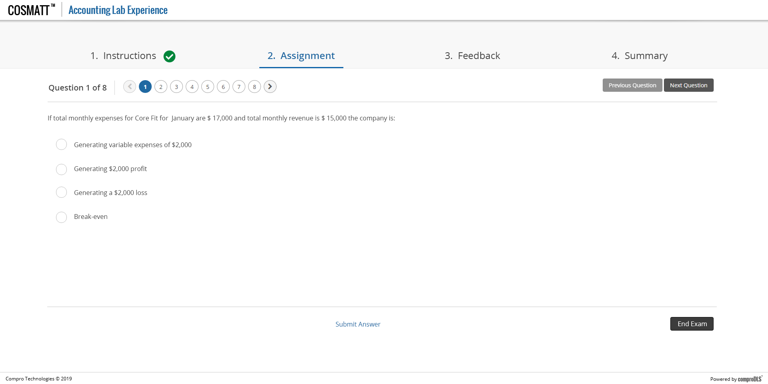
Mocks – Question Navigator

Slide 22
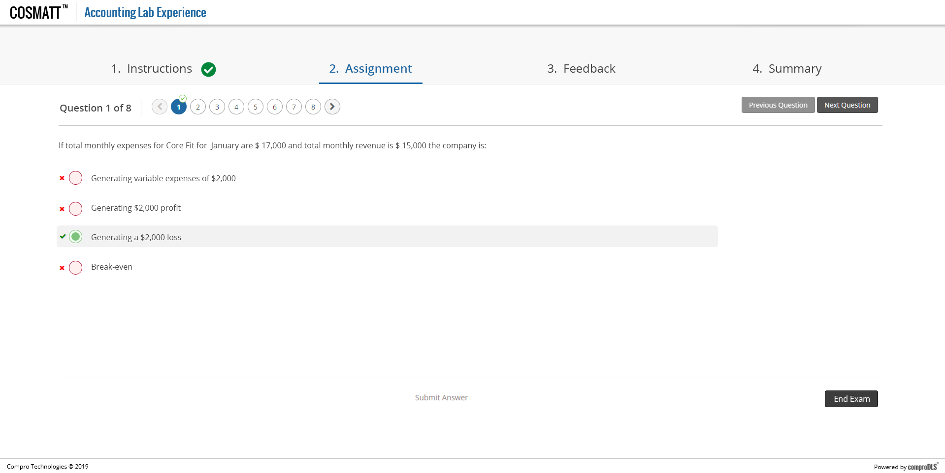
Mocks – Question Navigator

Slide 23
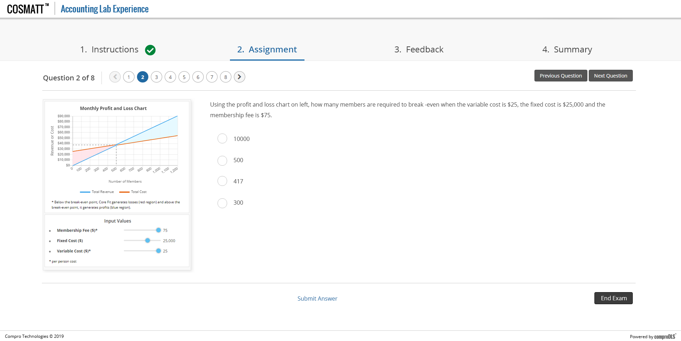
Mocks – Question Navigator

Slide 24
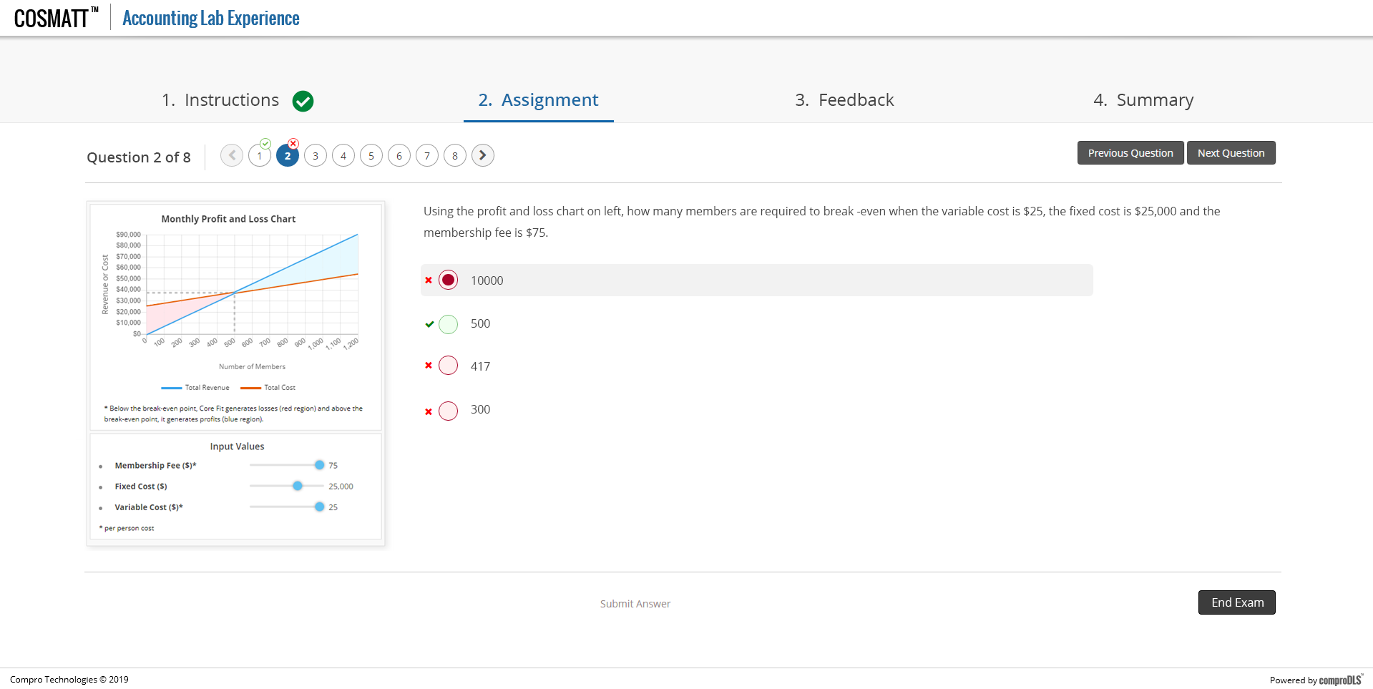
Mocks – Question Navigator

Slide 25
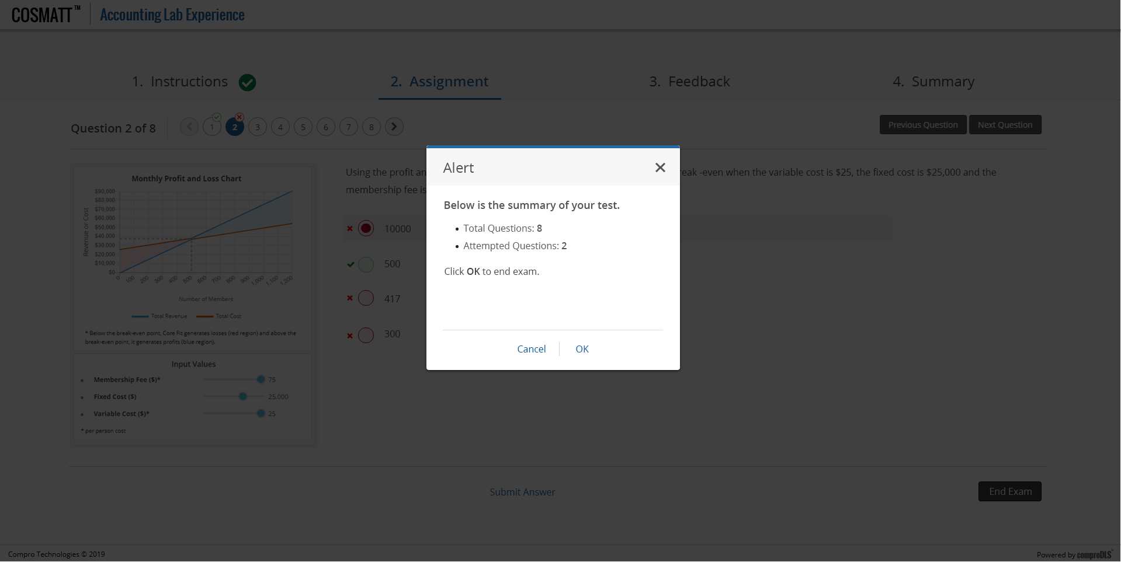
Mocks – Question Navigator

Slide 26
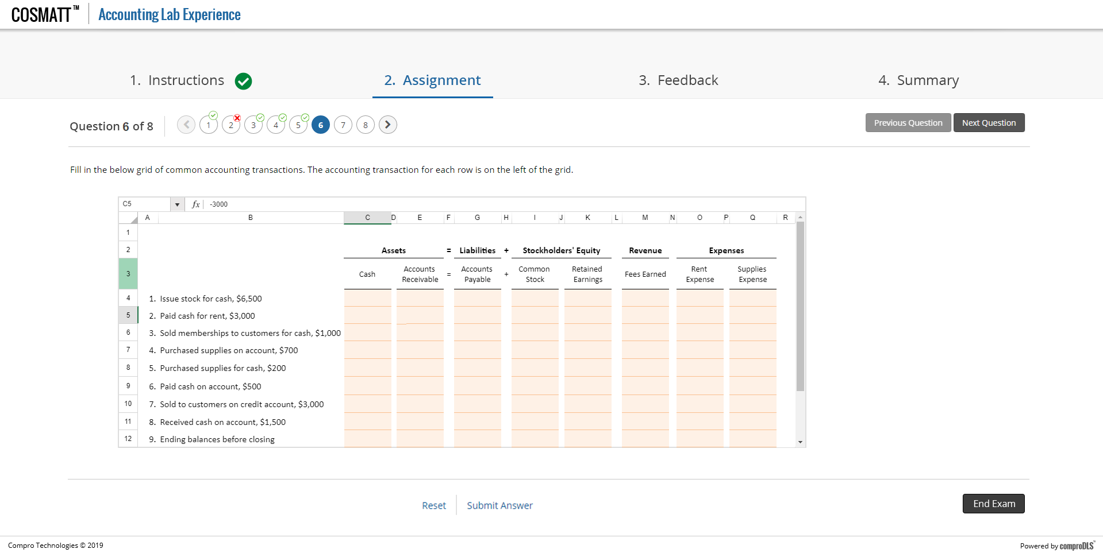
Mocks – Question Navigator

Slide 27
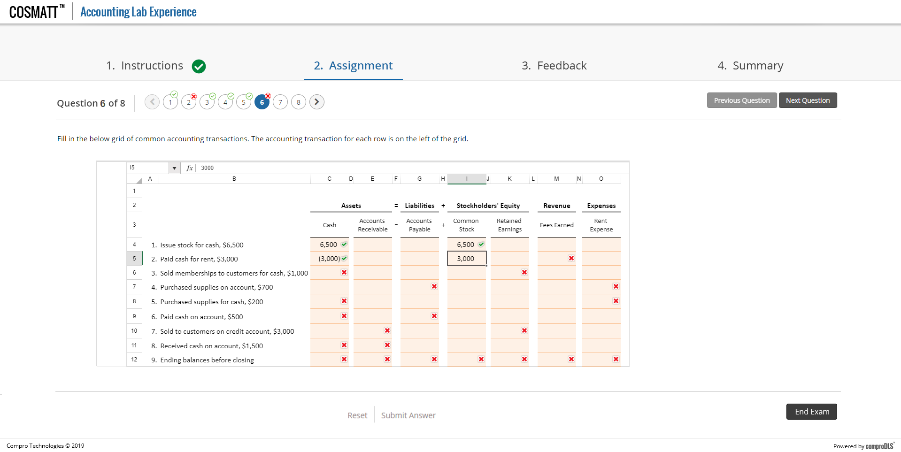
Mocks – Question Navigator

Slide 28
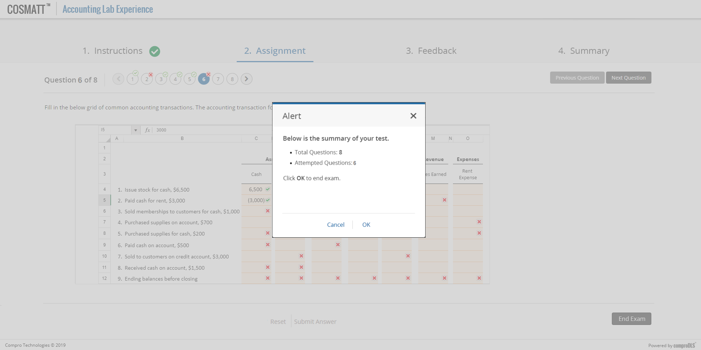
Mocks – Question Navigator

Slide 29
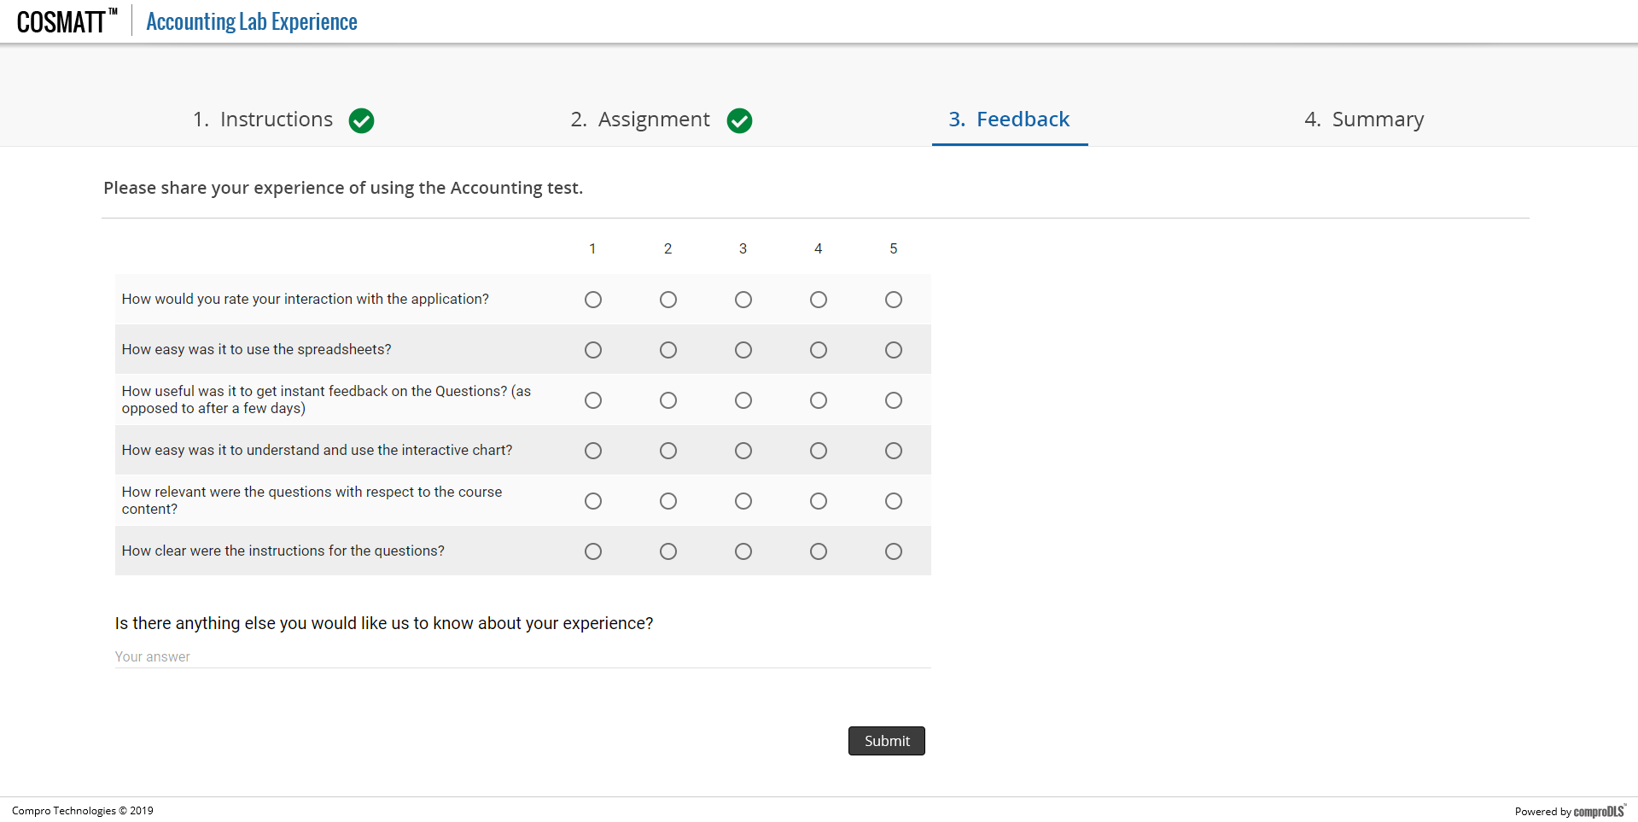
Mocks – Report
*Screen only for illustration purpose. Actual Questions need to be finalized Sample Survey

Slide 30
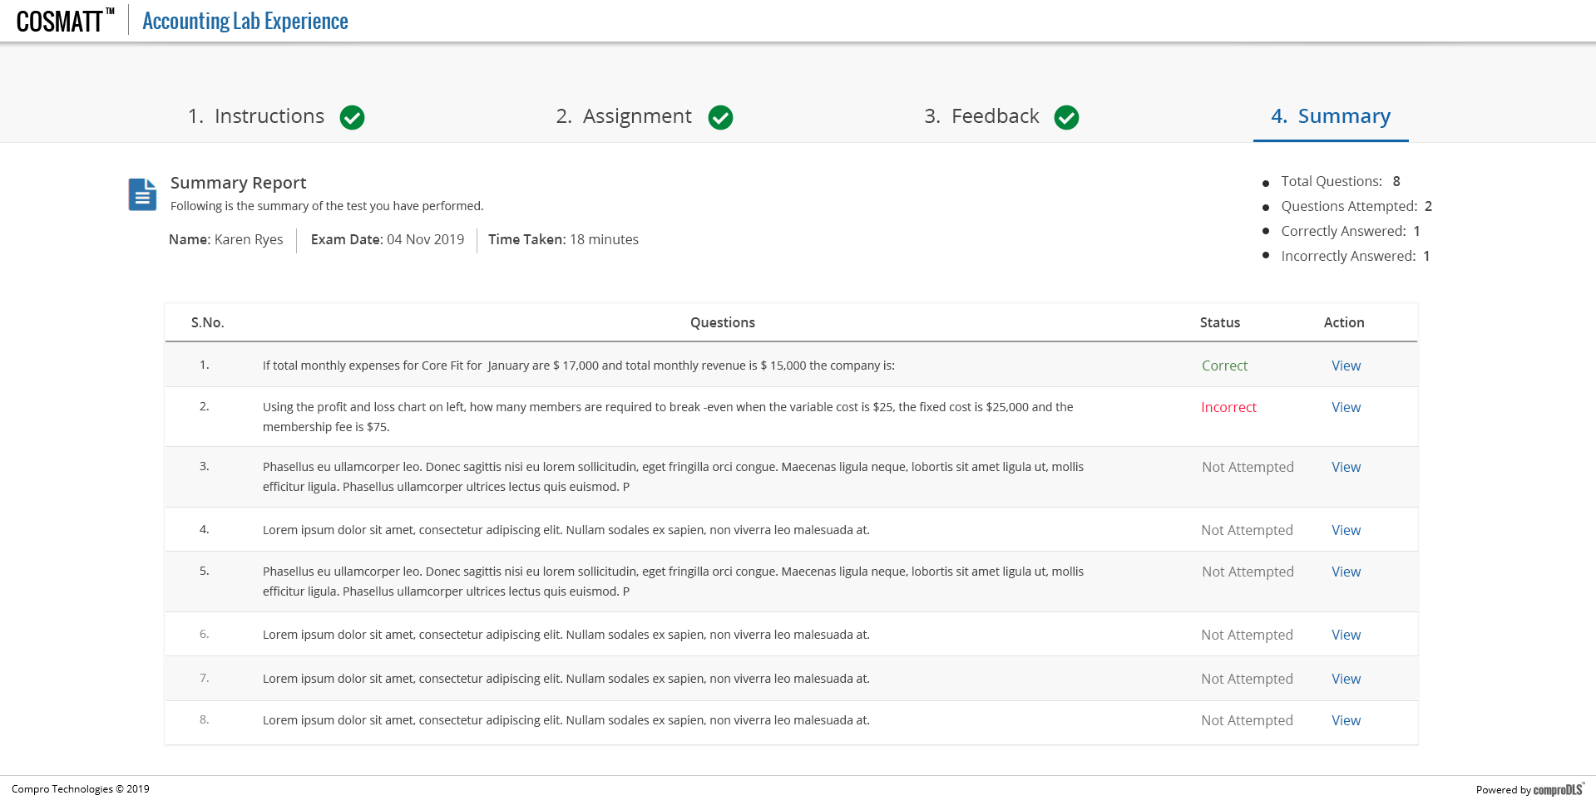
Mocks – Report

Slide 31
Instructor Workflow

Slide 32
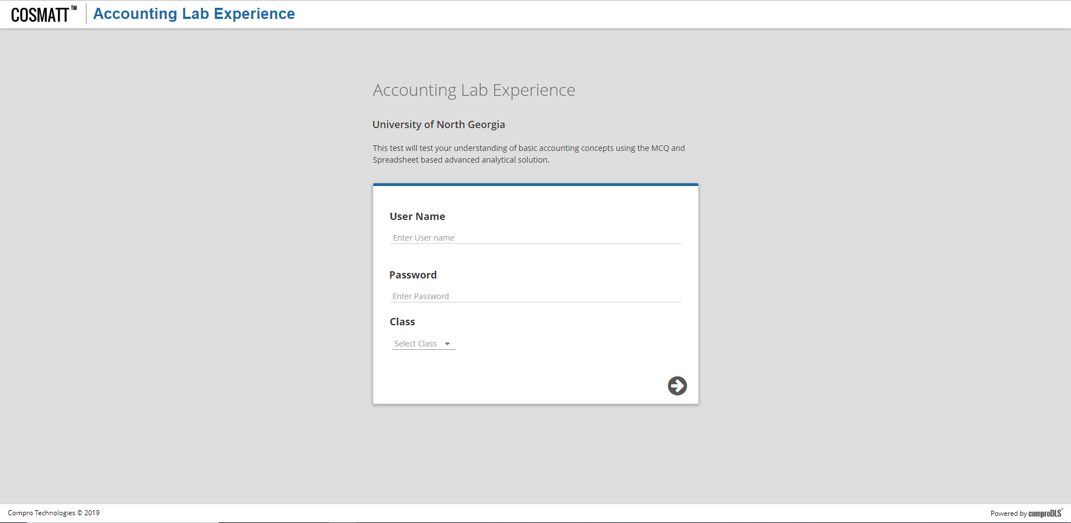
Mocks – Home Page

Slide 33
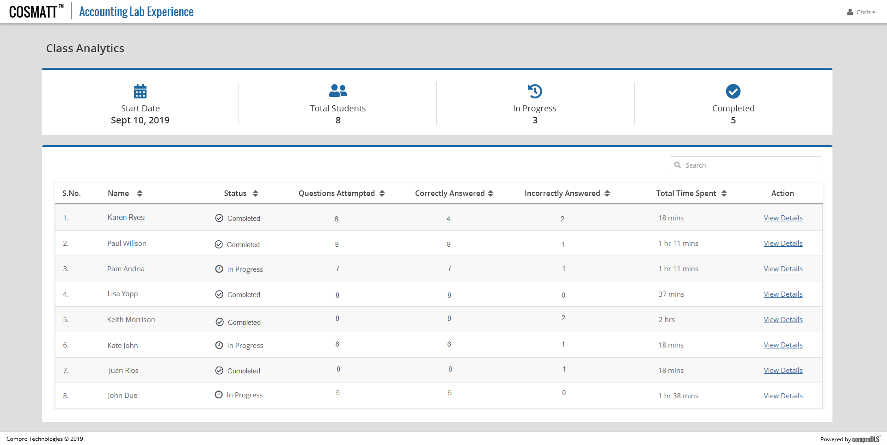
Instructor View - Reports

Slide 34
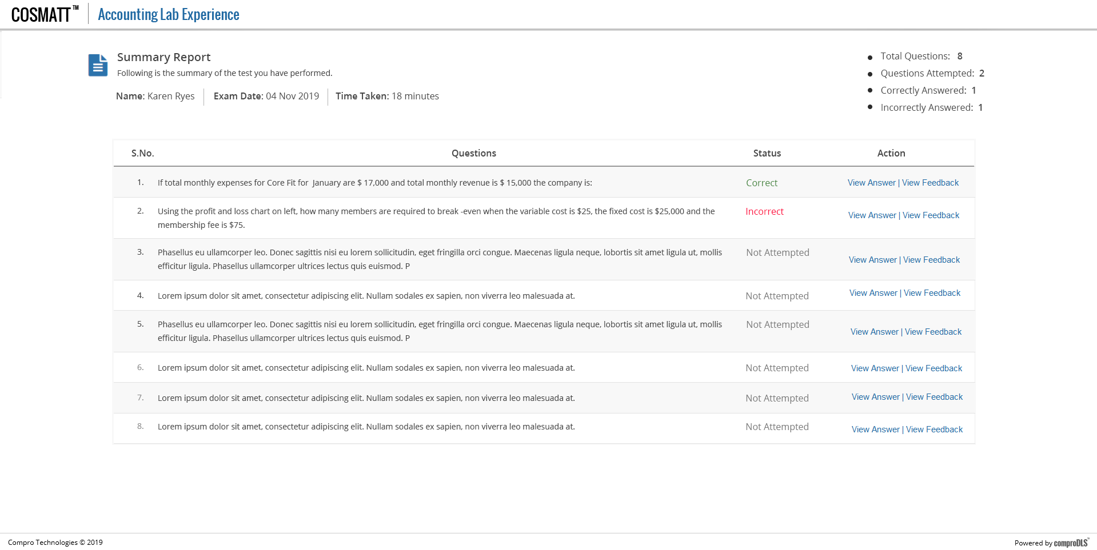
Mocks – Report

Slide 35
End Of Presentation
Notes:
35

Slide 36
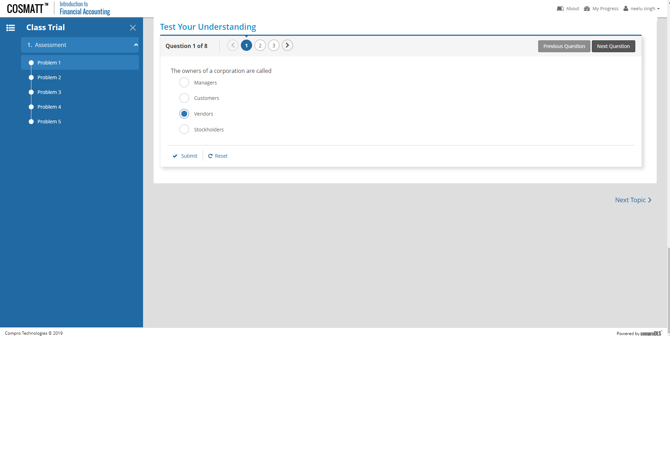
Option 2a: Questions as sections

